Slide 1
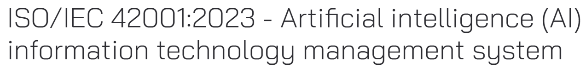
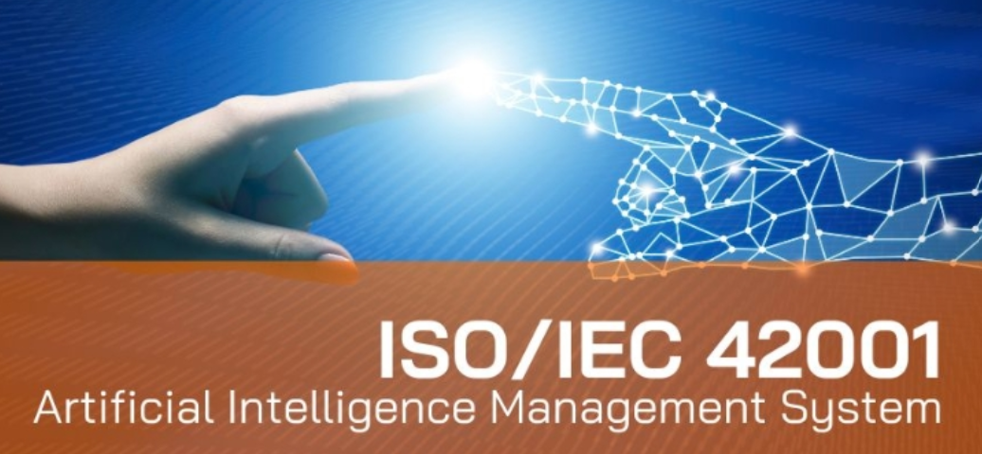

Slide 2
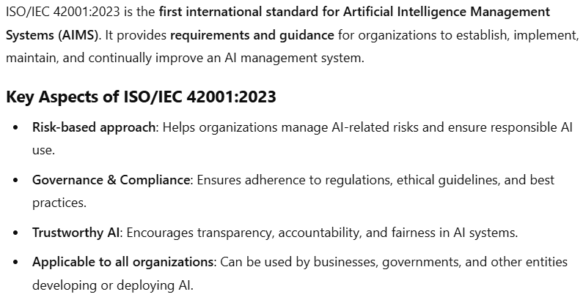
ISO 42001:2023 – What is it ?

Slide 3
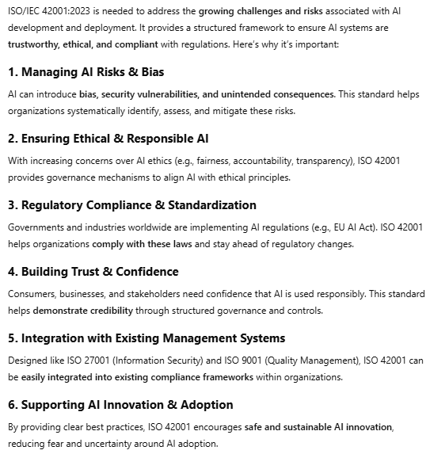
ISO 42001:2023
- Why is it required
- What value does it add
- Baseline Standards that it offers

Slide 4
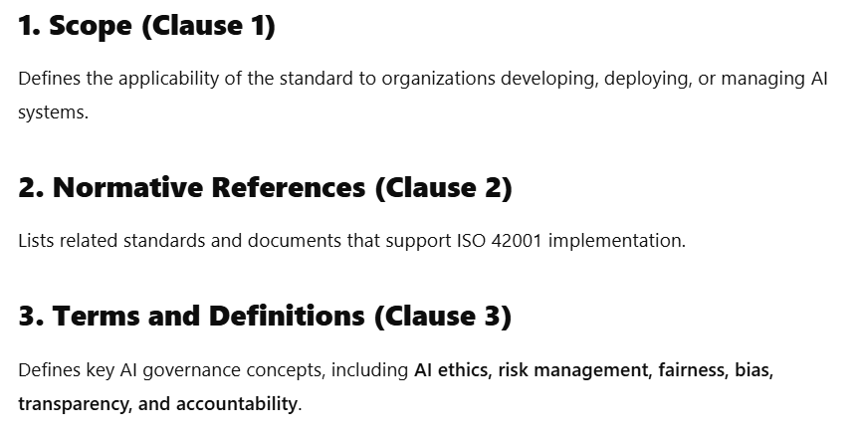
ISO 42001:2023 – Clauses 1 to 3

Slide 5
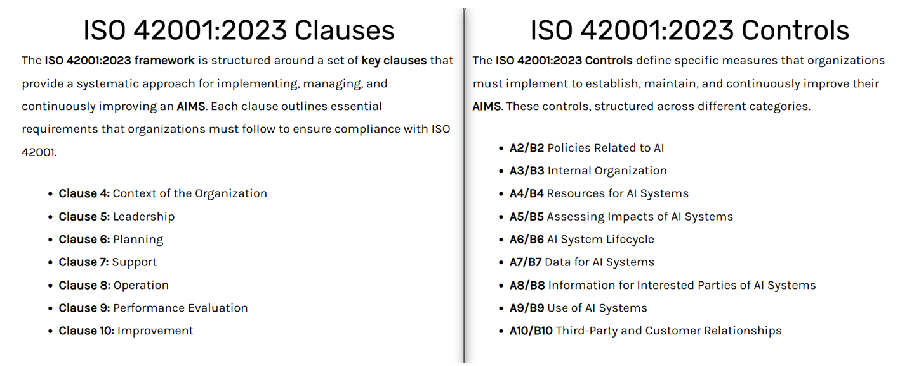
ISO 42001:2023 – Clauses & Controls

Slide 6
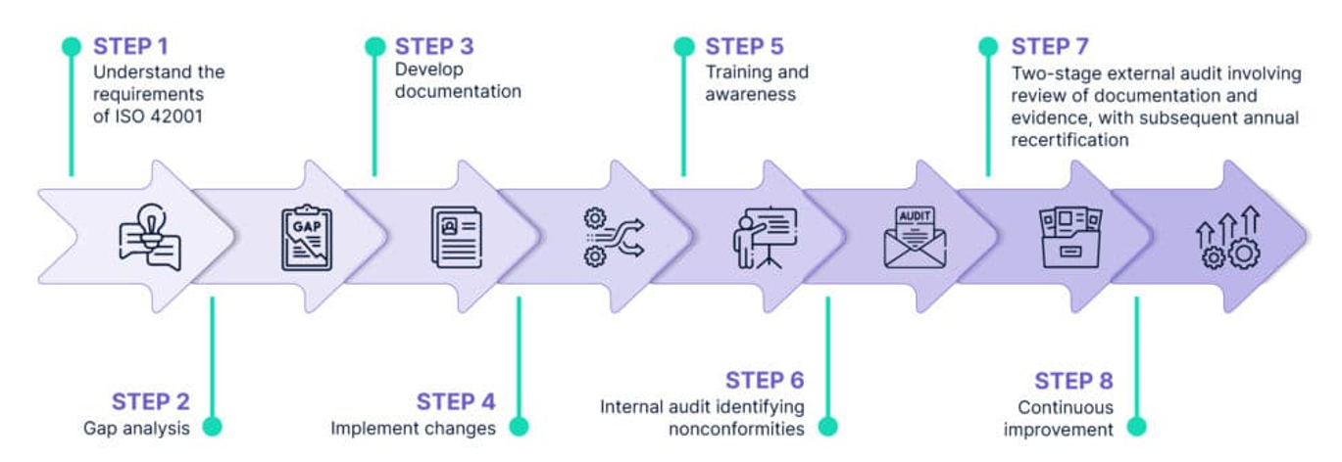
ISO 42001:2023 – Workflow for an ISO Audit

Slide 7
ISO 42001:2023 – The anatomy of SOA
Getting acquainted with ISO 42001:2023
- What it does
- How it helps the Organization
- Determine Organizational requirements on Scope
ISO 42001:2023 Clauses
ISO 42001:2023 Controls
- Invoke the Statement of Applicability
Applicability of Annexure A, B, C, D
Initial Discussion
Scope
Attaining Implementation
Certification
Invoke Security Assessment for GAP Analysis
Identifying Anomalies through Audit – Stage 1 > Stage 2
Publish a comprehensive report for Current sustaining AI/ML/GEN AI environment
Continuous Improvement based Surveillance

Slide 8
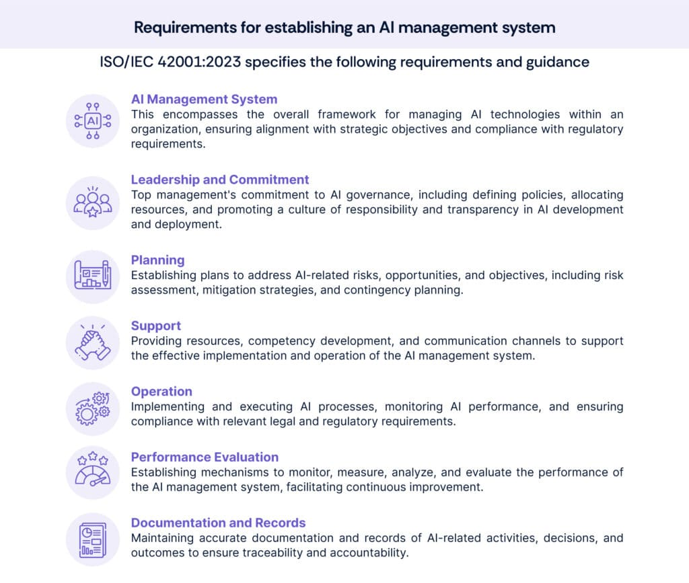
ISO 42001:2023 Key Components in Scope

Slide 9
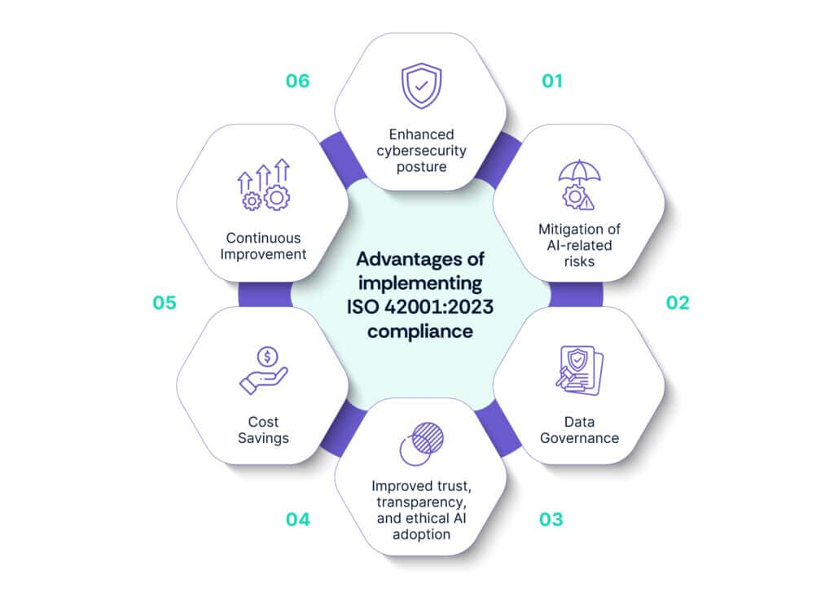
ISO 42001:2023 – Benefits that comes along

Slide 10
ISO 42001:2023 – Statement of Applicability

Slide 11
ISO 42001:2023 – Annexure A to D – Detailed Coverage

Slide 12
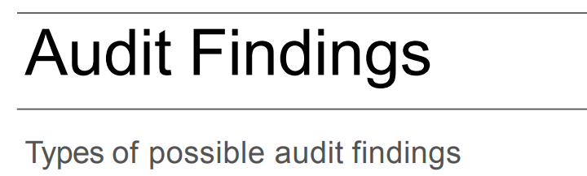
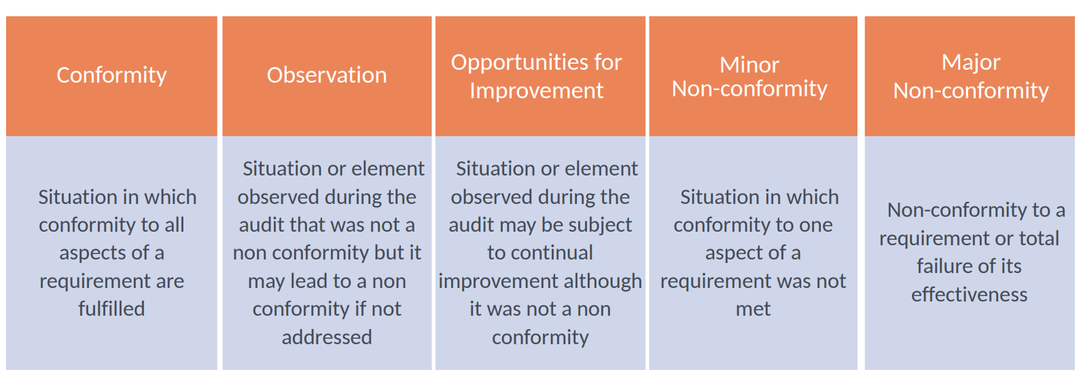

Slide 13
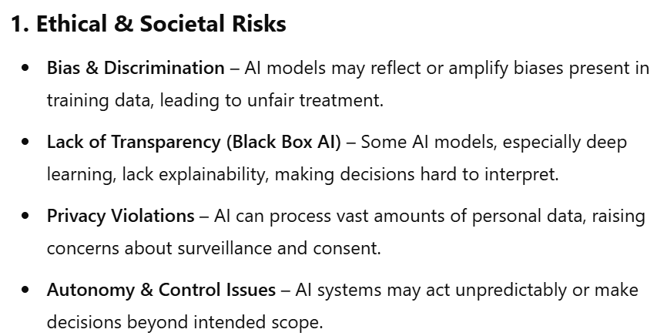
ISO 42001:2023 – Potential AI Risks

Slide 14
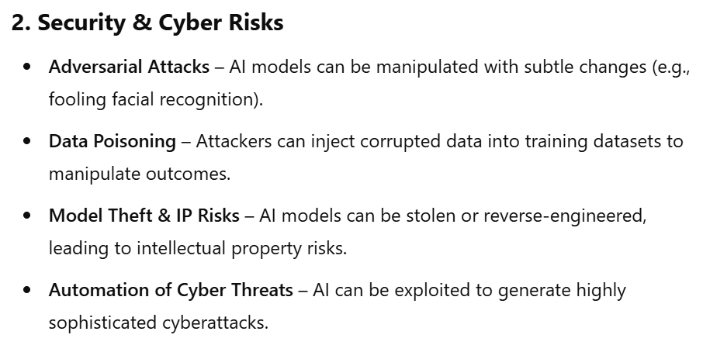
ISO 42001:2023 – Potential AI Risks

Slide 15
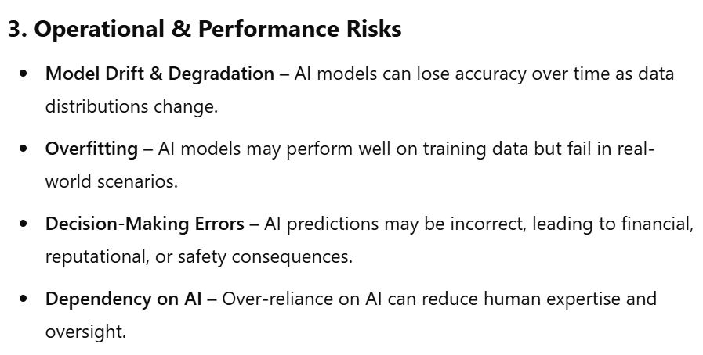
ISO 42001:2023 – Potential AI Risks

Slide 16
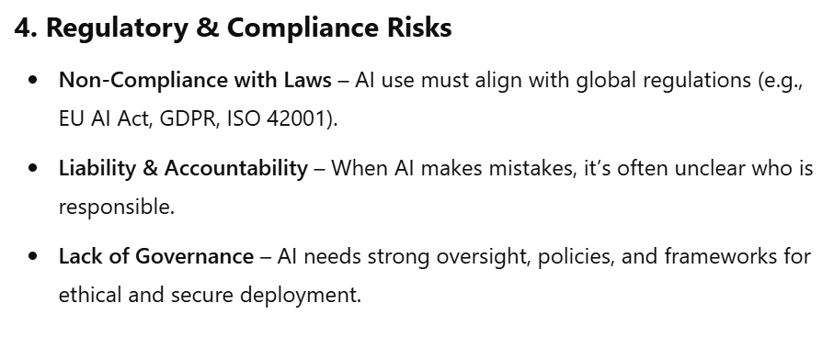
ISO 42001:2023 – Potential AI Risks

Slide 17
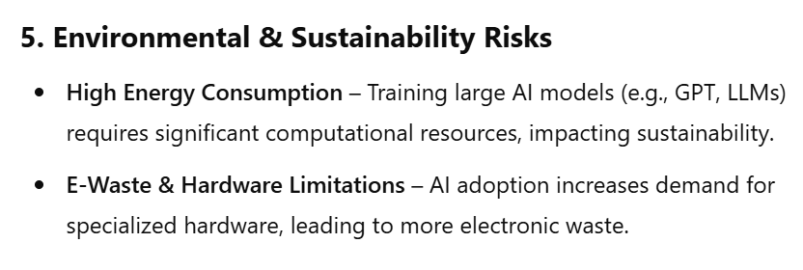
ISO 42001:2023 – Potential AI Risks

Slide 18
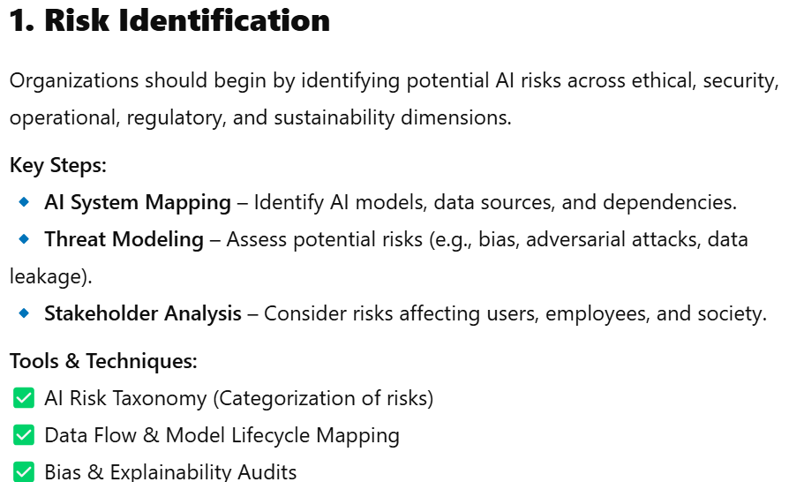
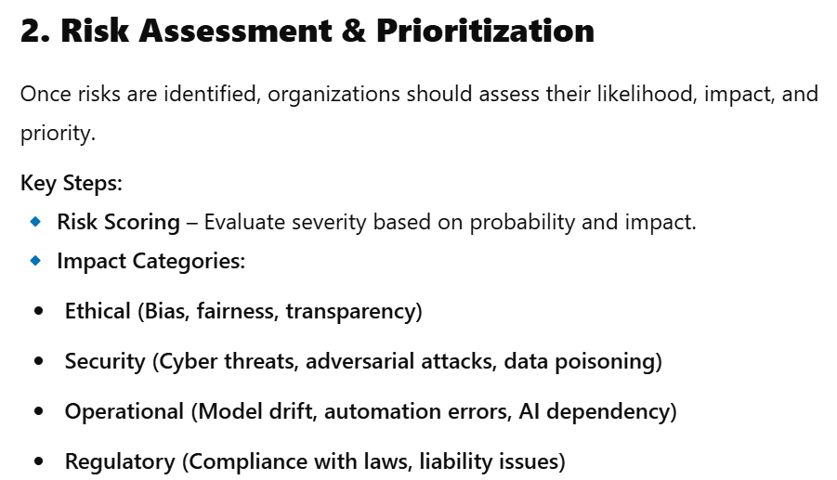
ISO 42001:2023 – AI Risk Mitigation Framework

Slide 19
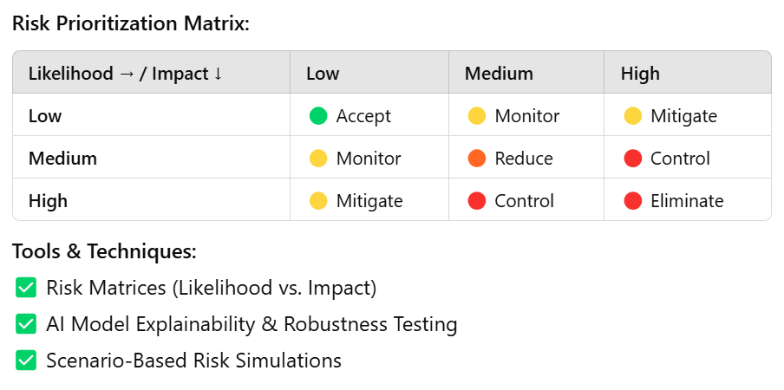
ISO 42001:2023 – AI Risk Mitigation Framework

Slide 20
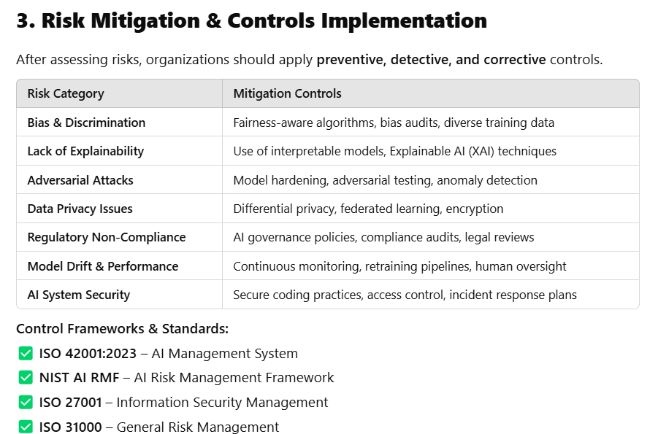
ISO 42001:2023 – AI Risk Mitigation Framework

Slide 21
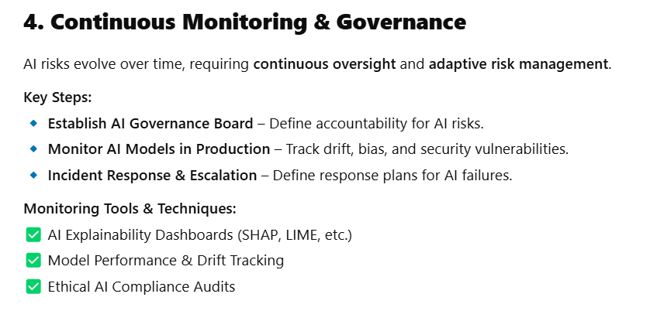
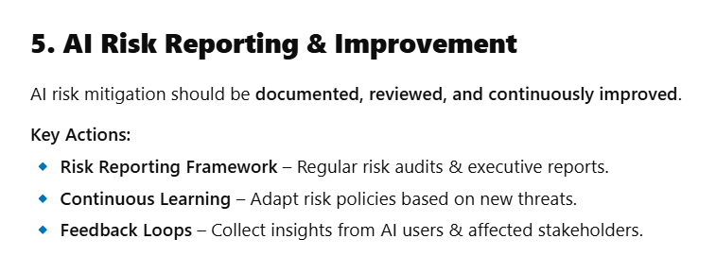
ISO 42001:2023 – AI Risk Mitigation Framework

Slide 22
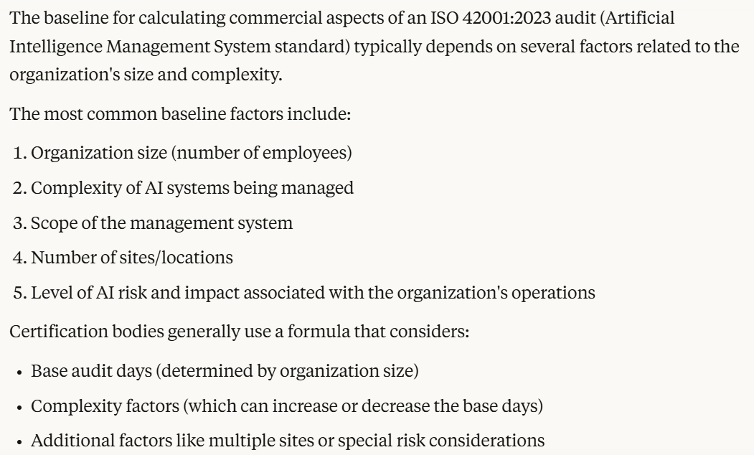
ISO 42001:2023 – Baseline for Commercials

Slide 23



Thank You

